Slide 1
Managing Ambiguity in Regression Ensembles
Yuri Zelenkov
Graduate School of Business
HSE University

Slide 2
Ensemble taxonomy
Tree based ensembles
Diversity-based
Complementarity-based
Random Subspaces
Random Forest
Bagging
Iterated Bagging
Gradient Boosting
Stochastic GB
Dart
Managing Ambiguity

Slide 3
Ambiguity Decomposition
Let f_{E} be an ensemble of M regressors f_{i}, i = 1…M, i.e. f_{E} is a convex combination of the individual estimators
According to (Krogh & Vedelsby , 1995 ), at an arbitrary single data point the quadratic error of the ensemble can be decomposed into two terms
weighted error
ambiguity
Krogh, A. and Vedelsby, J. (1995) Neural network ensembles, cross validation, and active learning. In Advances in neural information processing systems, pp. 231–238.

Slide 4
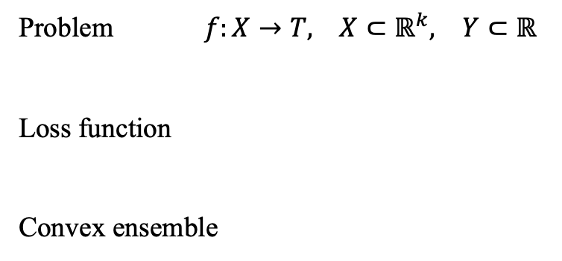
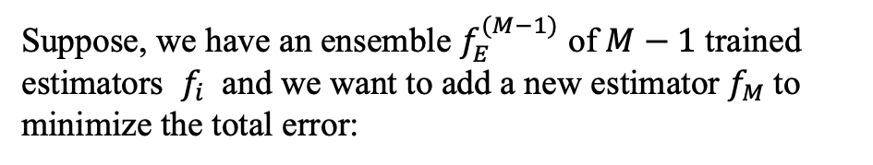
Mathematical Formulation - 1
Suppose, we have an ensemble $f_{E}^{(M−1)}$ of $M−1$ trained estimators $f_{i}$ and we want to add a new estimator $f_{M}$to minimize the total error:
Problem $f:X→T, X⊂ℝ^{k}, Y⊂ℝ$
Loss function
Convex ensemble
Let
, thus

Slide 5
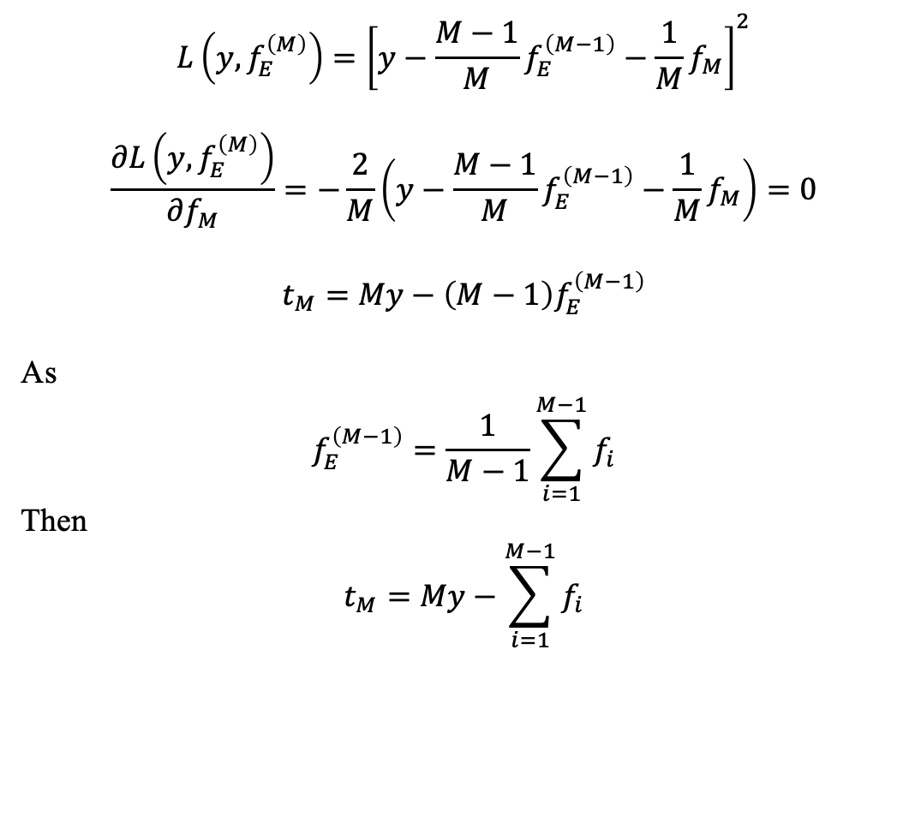

Mathematical Formulation - 2
$$L\left(y,f_{E}^{\left(M\right)}\right)={\left[y−\frac{M−1}{M}f_{E}^{\left(M−1\right)}−\frac{1}{M}f_{M}\right]}^{2}$$
$$\frac{∂L\left(y,f_{E}^{\left(M\right)}\right)}{∂f_{M}}=−\frac{2}{M}\left(y−\frac{M−1}{M}f_{E}^{\left(M−1\right)}−\frac{1}{M}f_{M}\right)=0$$
$$t_{M}=My−\left(M−1\right)f_{E}^{\left(M−1\right)}$$
As
$$f_{E}^{\left(M−1\right)}=\frac{1}{M−1}\sum_{i=1}^{M−1}{f_{i}}$$
Then
$$t_{M}=My−\sum_{i=1}^{M−1}{f_{i}}$$
Target to train $f_{M}$
It can also be shown that this expression can be obtained from the equality of error and ambiguity, Eq. 1.

Slide 6
Managing Ambiguity Algorithm

Slide 7
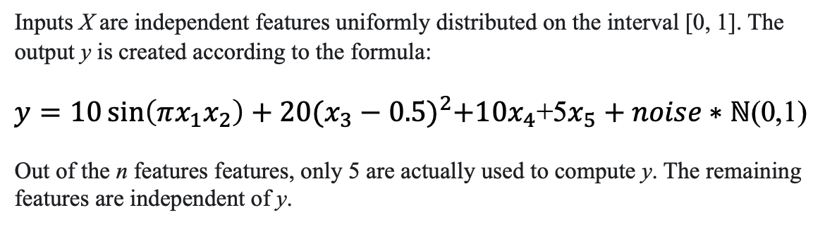
Synthetic Dataset
Inputs X are independent features uniformly distributed on the interval [0, 1]. The output y is created according to the formula:
$y=10\sin\left(πx_{1}x_{2}\right)+20{(x_{3}−0.5)}^{2}+10x_{4}$+5$x_{5}+noise∗ℕ$(0,1)
Out of the n features features, only 5 are actually used to compute y. The remaining features are independent of y.
sklearn.datasets.make_friedman1(n_samples=10000, n_features=20, noise=0.1, random_state=101)

Slide 8
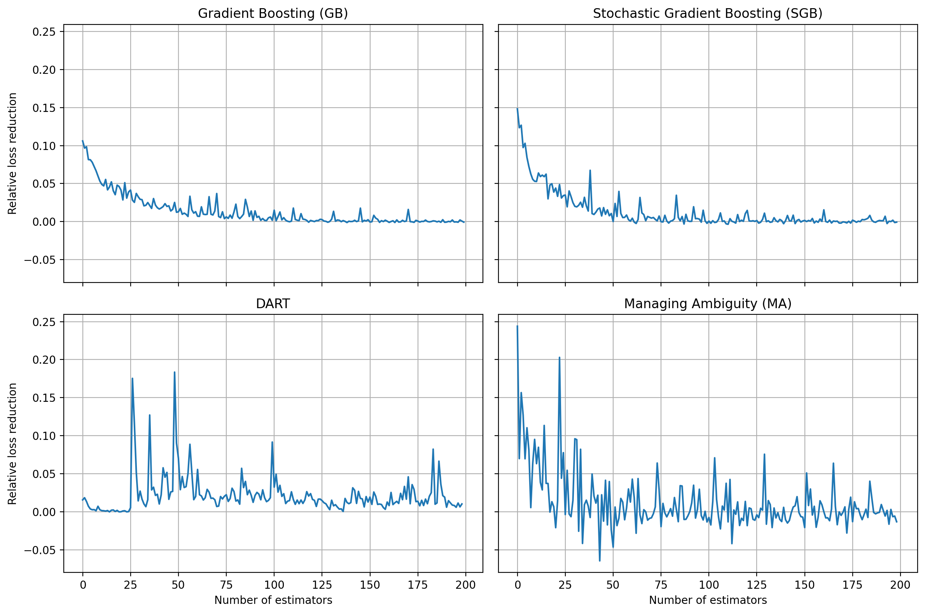
Comparison with Gradient Boosting

Slide 9
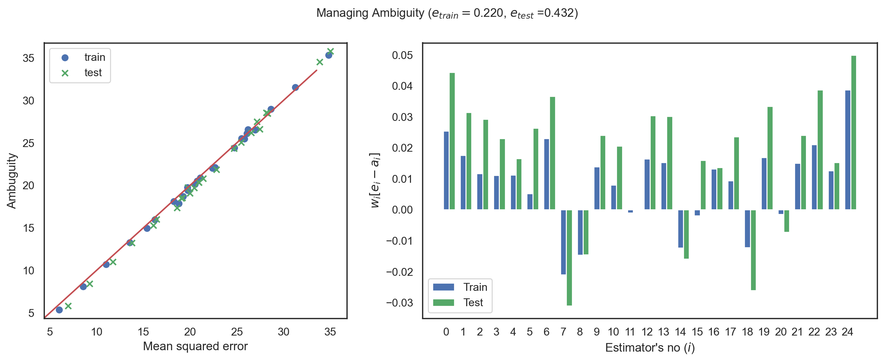
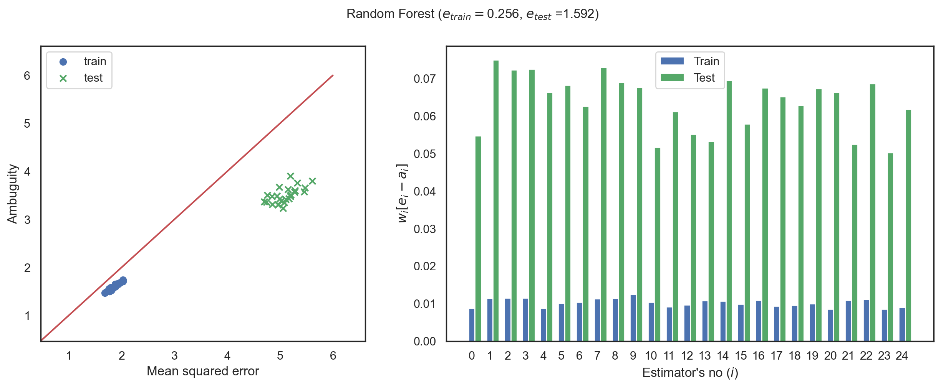
Comparison with Random Forest
train_test_split(test_size= 0.25)

Slide 10
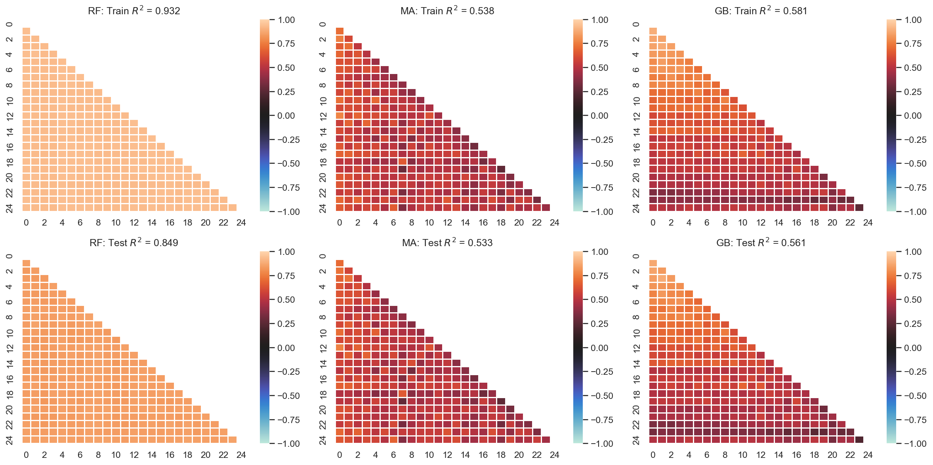

Slide 12
QUESTIONS?

